Slide 1
Welcome to the main event of the evening
A boxing bout for the WHBA Championship in the heavyweight division
Sanctioned by the Mani-Itilo Atheltic Commission
20 mins boxing rounds followed by Q&A Period
Notes:
This slide should start with the “rocky” music (play about 1 min and 30 sec)
https://www.youtube.com/watch?v=DhlPAj38rHc
and then at the same time in sequence, the following bullets appear
But SLOWLY 10 sec per line
Welcome to the main event of the evening
A Boxing bout for the vacant WHBA Championship in the Heavyweight division
Sactioned by the Mani-Itilo Athletic commission
20 min rounds of boxing followed by question and answer period
The theme
From whole genome sequencing to gene edtiting
*cut from moderator presentation
Leave beat up picture for longer
Time for eye of tiger
Question slides not automatic

Slide 2
The theme of the evening
From whole genome sequencing to gene editing
Friend or Foe?

Slide 3
Introducing the principals
Name
Tom Maniatis
Place of Birth
USA
50 wins
Score
Unreachable
Reach
1000+
Publications
325,420
Lifetime Citations
H-Index
147
Notes:
Introducing the principals
In the blue corner
The Tom-Tom-Toooooooooom Maniatis
His picture appears here photoshopped with gloves if possible
Currently Professor of ….
Born in USA
With a perfect professional record of winning 50 debates and losing none
Official Weight and height unknown
Reach: unreachable
Other notable achievements
Publications----
Lifetime citations---
H-Index

Slide 4
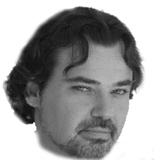
Introducing the principals
Nicholas
Katsanis
Name
Greece
Place of Birth
Score
49 wins 1 draw
Unreachable
Reach
Publications
1000+
Lifetime Citations
56,280
H-Index
106
Notes:
Introducing the principals
In the Red corner
The Stellar Stylianos Antonarakis
His picture appears here photoshopped with gloves if possible
Currently Professor of ….
Born in Greece
With a perfect professional record of winning 49 debates with one draw
Official Weight and height : You do not want to know
Reach: Very reachable
Other notable achievements
Publications----
Lifetime citations---
H-Index

Slide 5
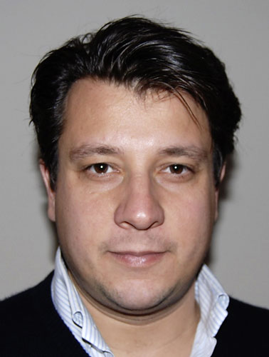
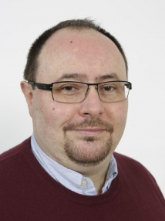
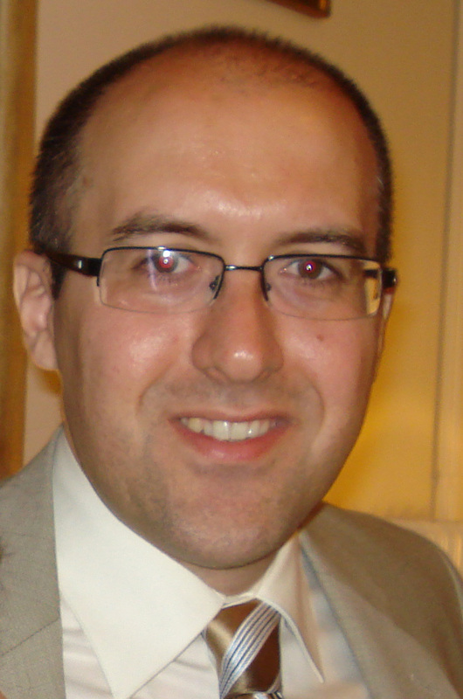
Scoring the bout at the ringside
Emmanuel Dermitzakis from Switzerland
Athanasios Mantalaris from England
Kostantinos Drosatos from USA
Notes:
Scoring the bout at the ringside
Emmanuel Dermitzakis fro Switzerland
Athanassios Mandalaris from england
And costantinos Drosatos from usa
Show pictures of all three here

Slide 6
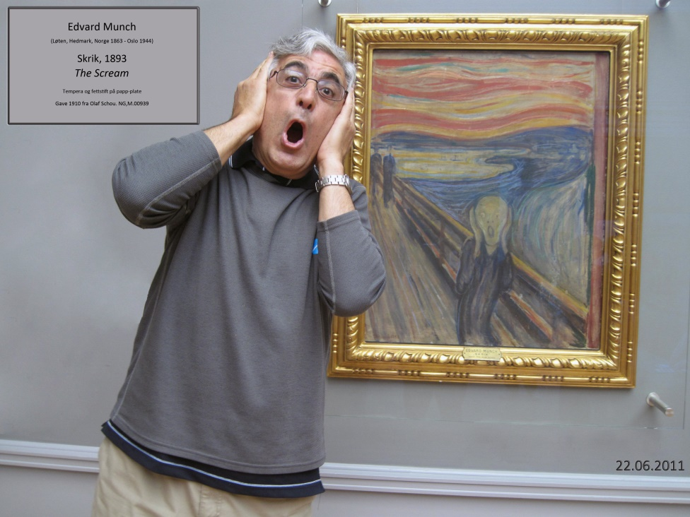
The Third man in the ring
The Moderator
Somebody who knows nothing about the subject but pretends he/she knows everything
Eleftherios P. Diamandis from Canada
Notes:
The third man in the ring
Eleftherios P. Diamandis from Canada
I will give you special picture here

Slide 7
Rules of the Game
Boxers who commit unintentional fouls receive a warning from the referee
Punches thrown by boxer must land above the waistline of the opposition
Only the doctor can stop the fight
Notes:
Rules of the game
Punches thrown by a boxer must land above the waistline of the opposition Only the doctor can stop the fight
A boxer hit with an unintentional low blow (a punch below the waist) has
up to five minutes to recover and will be considered knocked-out if he is unable to recover.
If a boxer cannot continue due to injury from an intentional foul,
the boxer who committed the foul will be disqualified.
Boxers who commit unintentional fouls receive a warning from the referee,
who can also deduct points from a boxer if the boxer continues to commit the foul.
Only the doctor can stop the fight
The referee does not score the fight
3- knockdown rule is in effect

Slide 8
Rules of the Game
If boxer cannot continue due to injury from an intentional foul, the boxer who committed the foul will be disqualified
The referee does not score the fight
3-knockdown rule is in effect
Notes:
Rules of the game
Punches thrown by a boxer must land above the waistline of the opposition
A boxer hit with an unintentional low blow (a punch below the waist) has
up to five minutes to recover and will be considered knocked-out if he is unable to recover.
If a boxer cannot continue due to injury from an intentional foul,
the boxer who committed the foul will be disqualified.
Boxers who commit unintentional fouls receive a warning from the referee,
who can also deduct points from a boxer if the boxer continues to commit the foul.
Only the doctor can stop the fight
The referee does not score the fight
3- knockdown rule is in effect

Slide 9
Additional rules
Drosatos will be the official recorder
Each presenter has 20 minutes to make his points
At the end of the presentations the moderator will open up question period
After each question, the moderator will ask who they think won the point by a raise of hands
Notes:
Additional Rules
Each presenter has 20 min to make his points
Ath the end of the presentations the moderator will open up the question period
Moderator and audience will ask the questions
After each question is answered by the contestants (max 3 min), the moderator will ask
audience who they think won the point by raising hands and the official recorder (Drosatos)
will give one point to th winner
Winner will be declared by talling the poins at the end of the contest
In case of equal poins the bout will be delared A DRAW!

Slide 10
Tale Of
The Tape
Notes:
The Tale of the Tape
Michelle, here you can do a very similar slide to the one attached but with our guys
Parameters to be used should include (antonarakis left/maniatis right)
Age put over 30 in each
Genetic composition greek/greek
Moustache/beard yes/no
Academic status professor/professor
Major awards and distinctions: Commander of the Order of Phoenix;HUGO President/Lasker; USA NAS
Nobel candidates Yes/Yes
Number of publications-------/over 1,000
Lifetime citations 63,000/ 325,000
H-index 119/ 146

Slide 11
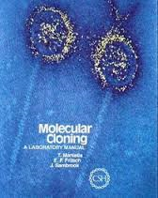
An Amazing statistic (as of april 2015)
Molecular Cloning (Sambrook/Fritsch/Maniatis; 1980 )
177,658 citations and 6,833 citations per year
Molecular Cloning: A Laboratory Manual
Maniatis/Fritsch/Sambrook; 1982)
57,645 citations and 1746 citations per year
Must be the top cited book of all time!
Notes:
The Bible Molecular Cloning (AKA Maniatis, AKA The Bible)
The first mention of Molecular Cloning as “The Bible” that I can find comes from a New York Newsday article (complete with cartoons of biologists stirring a witch’s cauldron) from 1984. Waclaw Szybalski is quoted as stating, “We have three or four copies in the lab. It’s our Bible.” Kevin Struhl made the same point in Nature in 1985, that, “This book is omnipresent in Molecular Biology laboratories and is utilized to the point where it is frequently referred to as ‘The Bible’.” As someone who started graduate school in 1987, I can attest to this as countless times my questions were answered by a point to the bookshelf and instructions to “read the bible.”

Slide 12
My attempt to address gene editing
Notes:
Three science fiction pieces
Here we put the first page of those;I will explain
How to Win Wimbledon Championships: Creating Beklof and Vamos
Clin. Chem., 55:6` 1253-1254 (2009). ISI: 000266687200039.pdf
Brain Transplantation
Unpublished Brain Transplantation.pdf
Tennis: Who is the greatest?
Unpublished: Who is the greatest tennis player.pdf

Slide 13
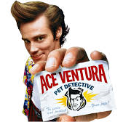
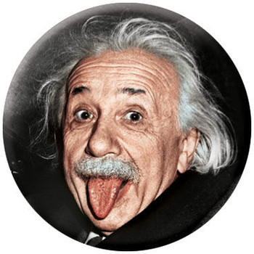
What can Gene editing Do?

Slide 14
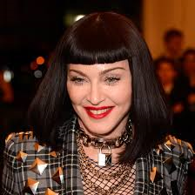
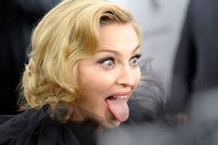
What can Gene editing Do?

Slide 15
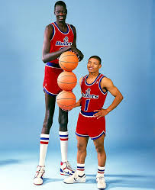
What can Gene editing Do?

Slide 16
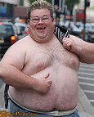
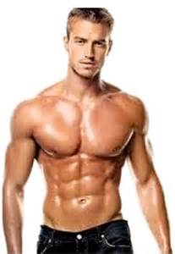
Just one nucleotide diff!

Slide 17
Just one nucleotide diff!

Slide 18
And now for those in attendance here
And millions of spectators around the world
LADIES AND GENTLEMEN
FROM VITILO, MANI, GREECE
Let’s Get Ready to Rumble
Notes:
Start with music first eye of the tiger
https://www.youtube.com/watch?v=btPJPFnesV4
For about 45 sec (just before the singing starts) and then stop/fade the music and showshow
And now
For Those in attendance here
And millions of spectators around the world
Ladies AND GENTLEMEN
From Vitilo,Mani,Greece
May 20th, 2015 (21st)
Itilo, Greece
LET’S GET READY TO RUMBLE

Slide 19
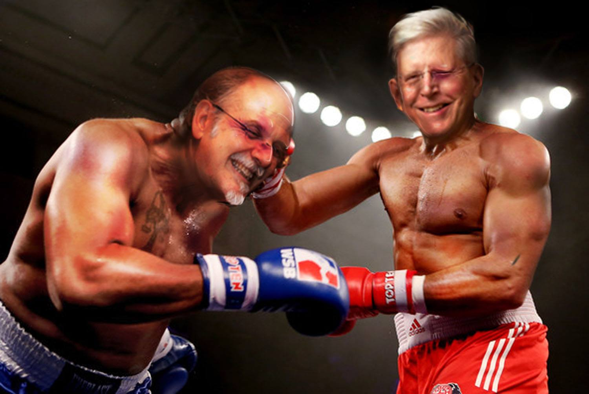
A word of caution
After the bout the contestants may look like this..
Notes:
A word of Caution
After the bout the contestants may look like this
Make some photoshop of both with blood dripping rom face and badly bruised!

Slide 20
Questions for Debate

Slide 21
Questions On Whole Genome Sequencing (WGS)
Can current WGS technology sequence 3 billion base-pairs with perfect accuracy? What if there are “some mistakes”?
Would these affect the interpretation?

Slide 22
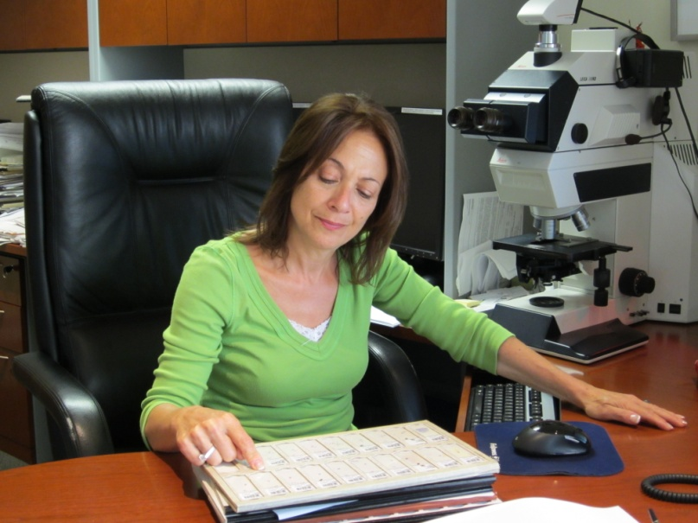
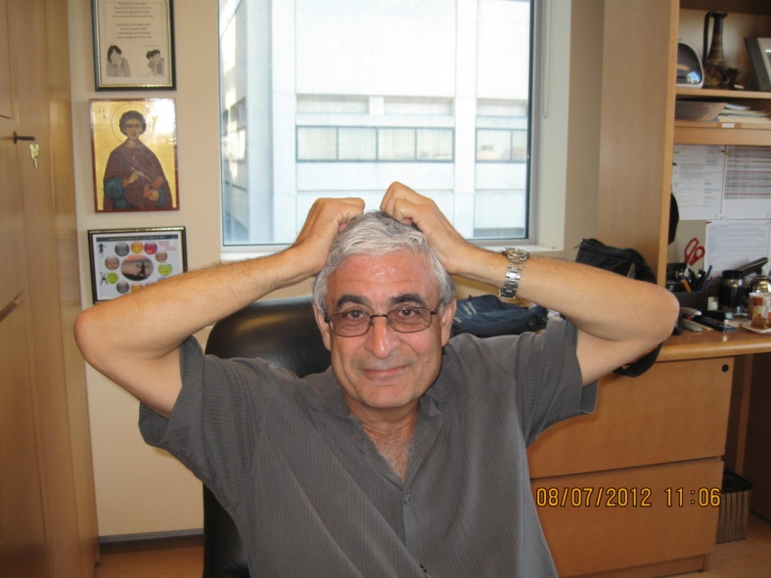
It may be a remnant from
Plato’s Genome
I found this SNV in your genome…
or… you may have
cancer

Slide 23
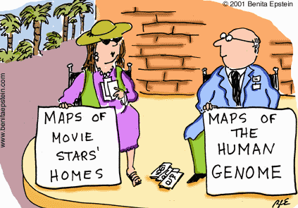
If you sequence your genome now
Can it be reliably interpreted ?
Who will interpret it ?
What is a good use of the information?
Could you give an example?

Slide 24
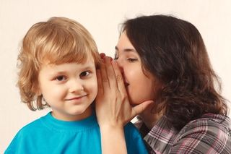
Have you sequenced your genome?
If yes, what was the most useful info you got?
If no, why not?
Would you sequence the genome of your children without asking them?
If there are “problems”, when would you tell them?

Slide 25
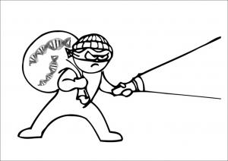
Are you worried
That Somebody may steal your genome?
Who that somebody could be?
Why people may “steal” genomes?
Can people make money by stealing and selling genomes? To whom? Why?
Can your genome be stored with zero chance of being hijacked?

Slide 26
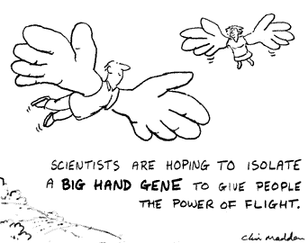
Killer application
If I ask you to select one “killer” application of WGS NOW (2015), which one would that be?

Slide 27
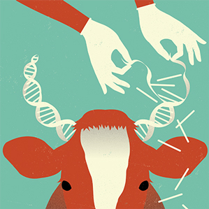
Gene editing questions
Do you mind editing the germline of animals NOW, to make “better” animals in terms of meat or milk production or for making better models of human diseases?

Slide 28
Human germline
There is gene editing of the germline (inherited) and somatic cells (not inherited)
Assuming technology is safe and effective
What is wrong with:
Short couples wanting tall children?
Ugly couples wanting good looking children?
Stupid couples wanting..more stupid children?

Slide 29
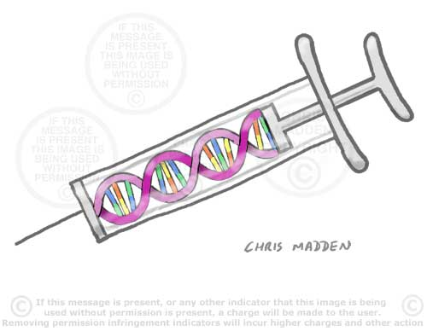
Inherited human diseases
Genome editing of germ cells could theoretically eradicate all inherited disorders
Why don’t we try with cystic fibrosis as a model and see what happens?

Slide 30
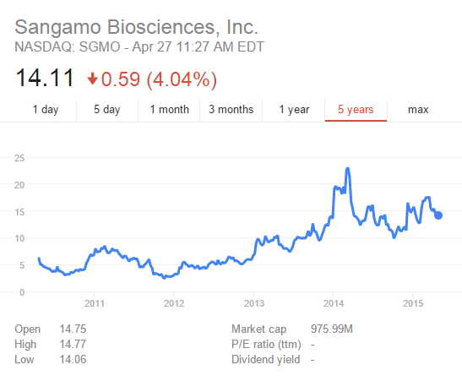
Investment
Would you buy stock (invest) in a therapeutic gene editing company such as Sangamo?

Slide 31
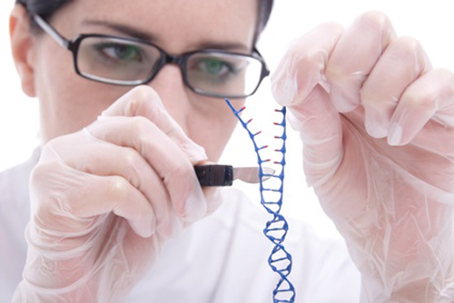
Imagine:
How would you imagine a world full of genetically modified people? Like
All tall, beautiful, athletic, healthy, smart
And/or nasty, ruthless, etc?
A better world?
A wild world?
A jungle?

Slide 32
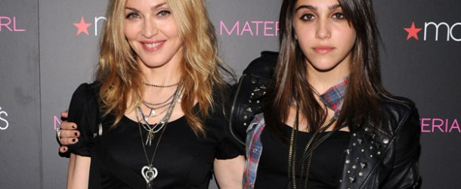
Your preference
Would you prefer that your children inherit your genes and some of your traits, or you wouldn’t care less?

Slide 33
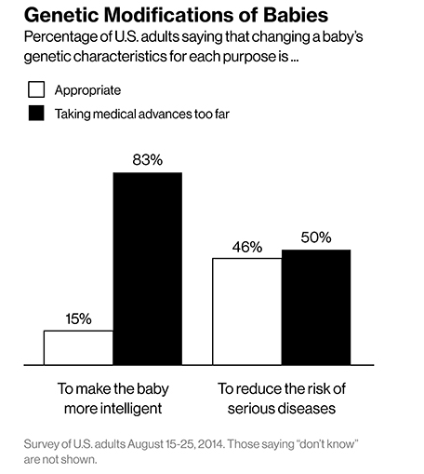
Survey
A survey about gene editing in humans produced the results below
Your comments?

Slide 34
The “Cut to the chase question”
Should human science try to improve the human species by genetic engineering, or never touch this issue?

Slide 35
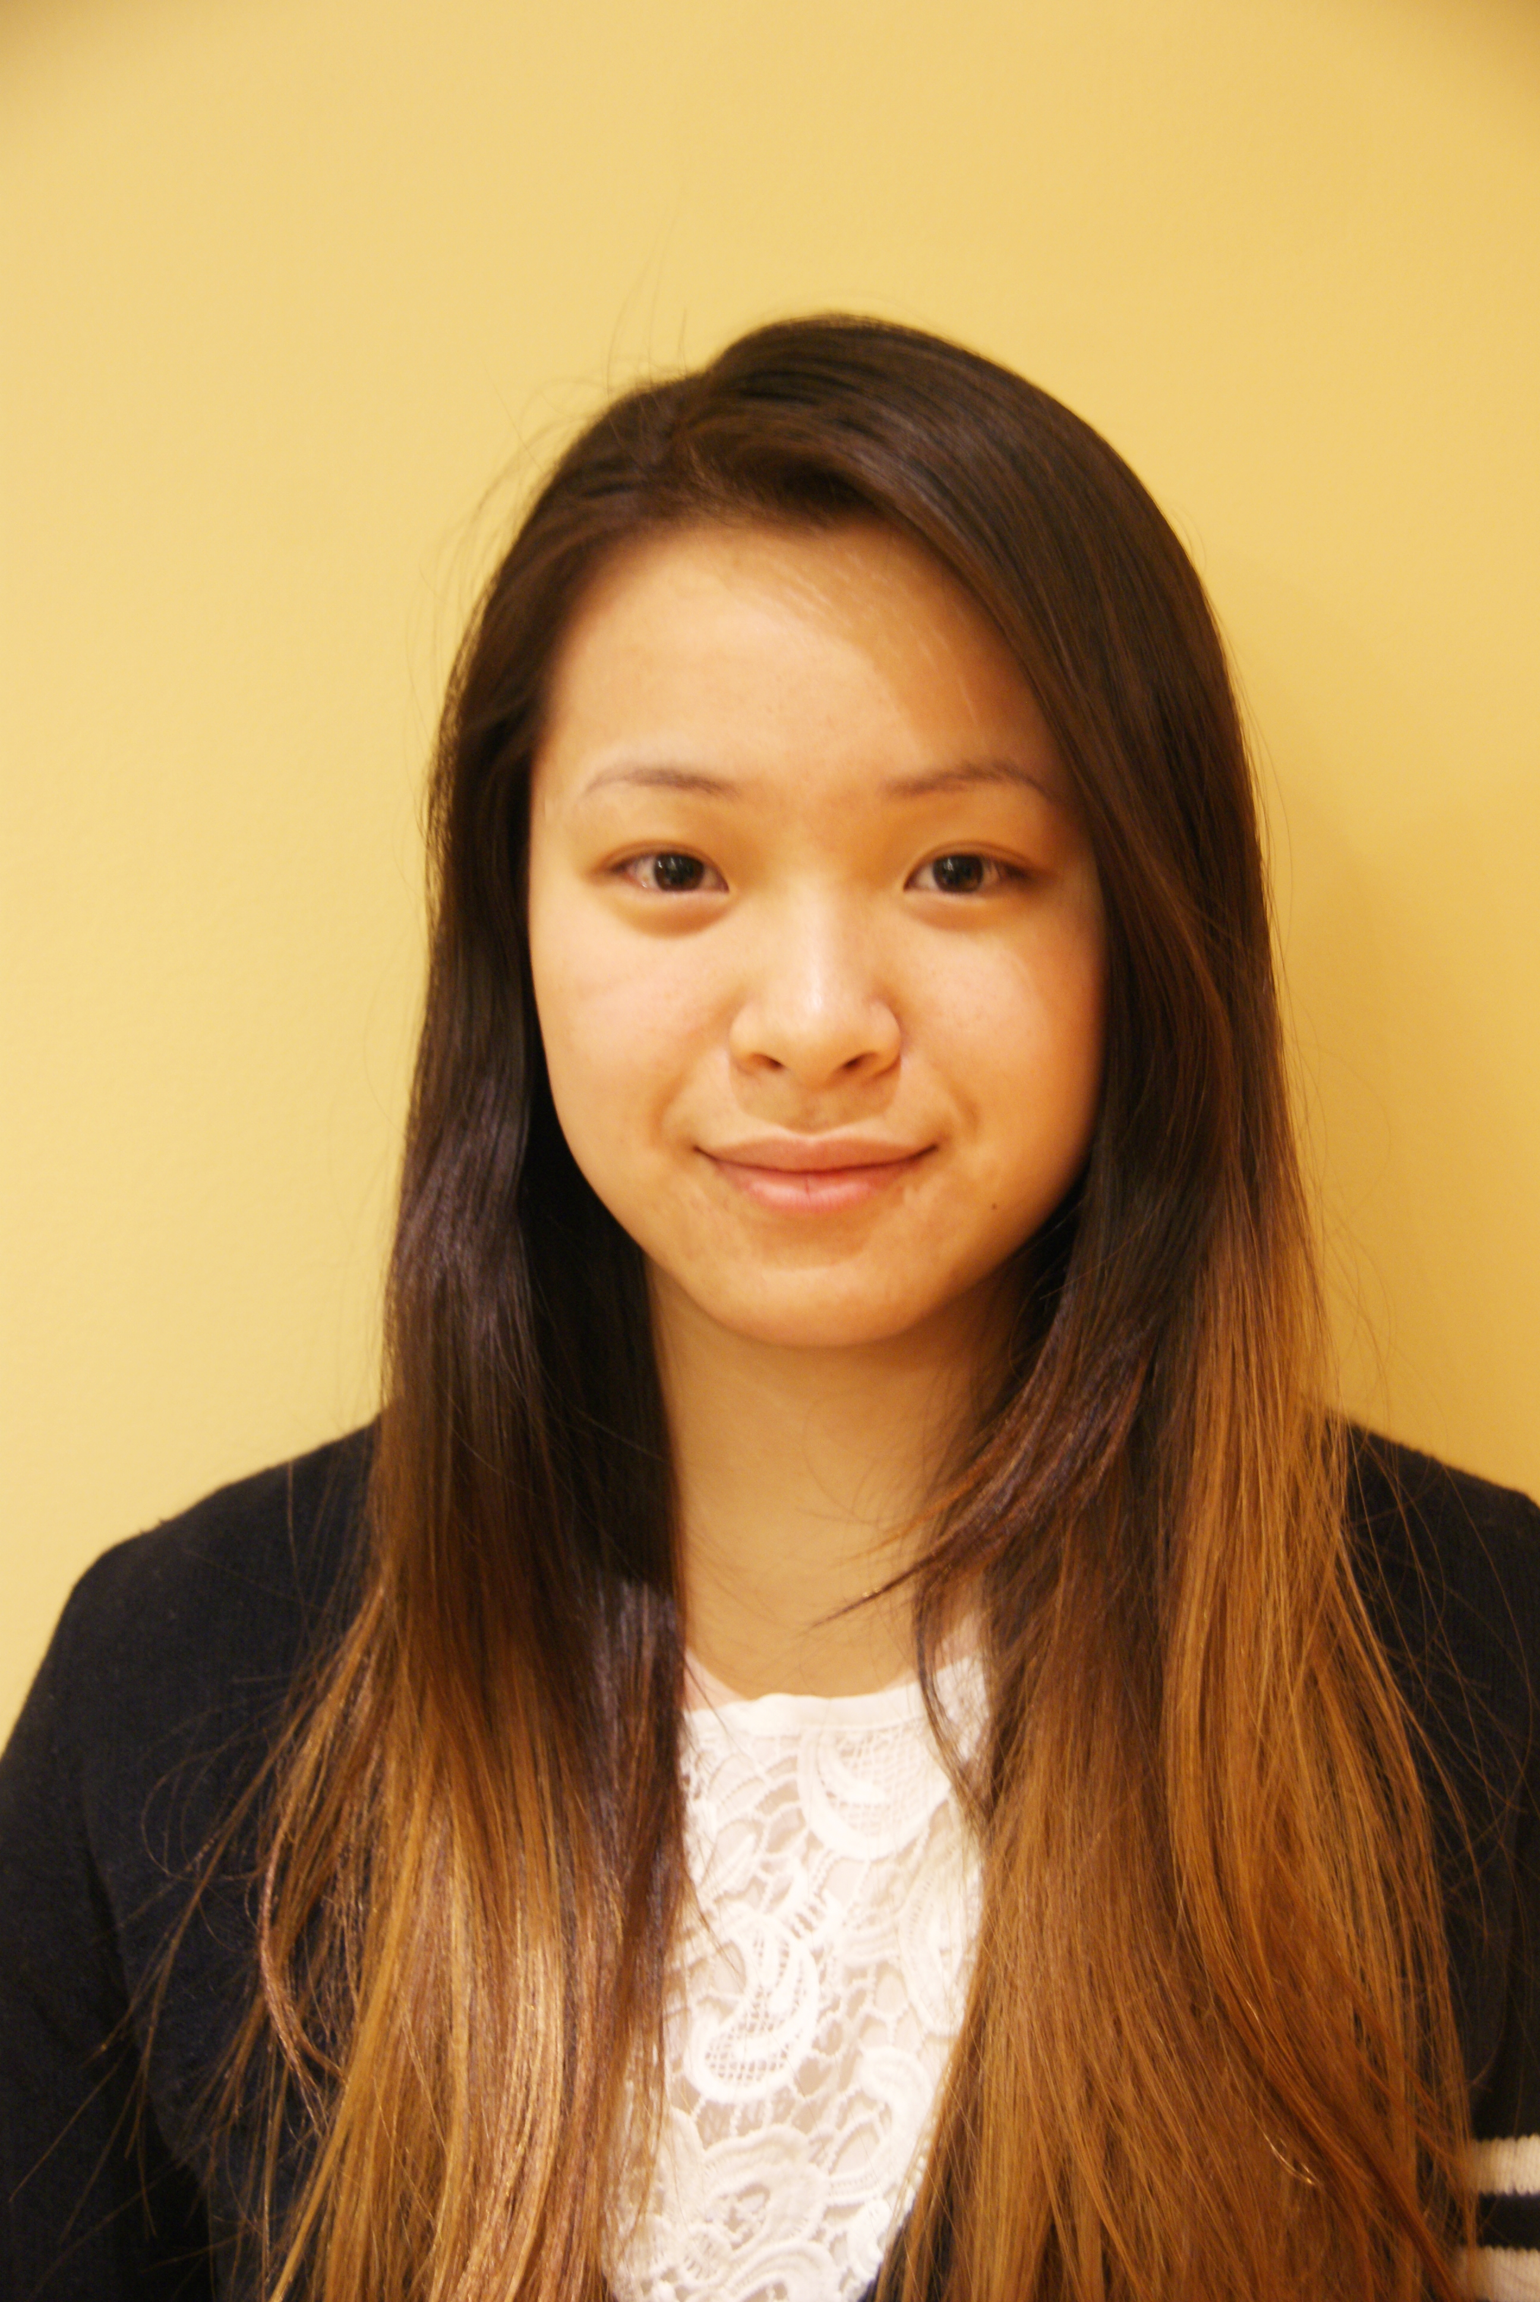
Thank you to Michelle Li for preparation of this presentation
Notes:
Start with music first eye of the tiger
https://www.youtube.com/watch?v=btPJPFnesV4
For about 45 sec (just before the singing starts) and then stop/fade the music and showshow
And now
For Those in attendance here
And millions of spectators around the world
Ladies AND GENTLEMEN
From Vitilo,Mani,Greece
May 20th, 2015 (21st)
Itilo, Greece
LET’S GET READY TO RUMBLE

